Slide 1
Module 10
Implementing File and Print Services
Notes:
Presentation: 80 minutes
Lab: 60 minutes
After completing this module students should be able to:
Secure files and folders.
Protect shared files and folders by using shadow copies.
Configure the Work Folders role service.
Configure network printing.
Required Materials
To teach this module, you need the Microsoft® Office PowerPoint® file 20410D_10.pptx.
Important: We recommend that you use Office PowerPoint 2007 or a newer version to display the slides for this course. If you use PowerPoint Viewer or an older version of Office PowerPoint, all the features of the slides might not display correctly.
Preparation Tasks
To prepare for this module:
Read all of the materials for this module.
Practice performing the demonstrations and the lab exercises.
Work through the Module Review and Takeaways section, and determine how you will use this section to reinforce student learning and promote knowledge transfer to on-the-job performance.
20410D
10: Implementing File and Print Services

Slide 2
Module Overview
Securing Files and Folders Protecting Shared Files and Folders by Using Shadow Copies Configuring Work Folders Configuring Network Printing
Notes:
Provide a brief overview of the module contents.
20410D
10: Implementing File and Print Services

Slide 3
Lesson 1: Securing Files and Folders
What Are File Permissions? What Are Shared Folders? Permissions Inheritance Effective Permissions What Is Access-Based Enumeration? What Is the Offline Files Feature? Demonstration: Creating and Configuring a Shared Folder
Notes:
Briefly describe the lesson content.
20410D
10: Implementing File and Print Services

Slide 4
What Are File Permissions?
File permissions control access for files and folders on NTFS or ReFS formatted storage volumes
File Permissions:
Are configured for files or folders
Can be granted or denied
Are inherited from parent folders
Permissions conflict precedence:
1. Explicitly assigned Deny
2. Explicitly assigned Allow
3. Inherited Deny
4. Inherited Allow
Notes:
This topic introduces the key concepts about file sharing permissions. It also touches briefly on topics that you will discuss later in this lesson, such as permissions types and inheritance.
First, identify specifically what file permissions are, and explain how you assign them.
The examples in the handbook may be useful in illustrating the basic concepts of file permissions.
Reinforce the precedence rules, which the handbook lists as:
Explicit Deny
Explicit Allow
Inherited Deny
Inherited Allow
20410D
10: Implementing File and Print Services

Slide 5
What Are Shared Folders?
Shared folders grant network access to their contents
Folders can be shared, but individual files cannot
Shared folders can be hidden by creating a share with a $ at the end of the share name
Accessing a shared folder using the UNC path:
\\LON-SVR1\Sales (standard share)
\\LON-SVR1\Sales$ (hidden share)
Administrative shares are hidden shares that allow administrators access to the root of every volume and special system folders, such as the operating system folder
Notes:
Discuss why shared folders are both necessary and helpful.
Explain that you can help secure shared folders by assigning permissions. For example, mention that a best practice is to grant only Authenticated Users access to the share.
20410D
10: Implementing File and Print Services

Slide 6
Permissions Inheritance
Inheritance is used to manage access to resources without explicitly assigning permissions to each object
By default, permissions are inherited in a parent/child relationship
Blocking inheritance:
You can block permission inheritance
You can apply blocking at the file or folder level
You can set blocking on a folder to propagate the new permissions to child objects
Notes:
Explain how parent and child permissions work. Use the whiteboard to draw a directory structure and show how permissions propagate downward, and discuss how inheritance is useful to manage a large number of objects.
Explain how blocking clears the permissions from an object and the result of this action. Additionally, explain how blocking and propagating to child objects can create scalable management of a large number of objects.
20410D
10: Implementing File and Print Services

Slide 7
Effective Permissions
When combining file system and shared folder permissions, the most restrictive permission is applied
Example: If a user or group has the shared folder permission of Read and the file system permission of Write, the user or group will only be able to read the files in the folder because it is the more restrictive permission
The user must have both file system and shared folder permissions, otherwise the user will be denied access to the resource
Notes:
Describe the key aspects of effective file permissions, and point students to the Effective Access tool.
Relate the key points for accessing a shared folder, and discuss how shared folder and file permissions apply.
20410D
10: Implementing File and Print Services

Slide 8
What Is Access-Based Enumeration?
Access-based enumeration allows an administrator to control the visibility of shared folders according to the permissions set on the shared folder
Access Based Enumeration is:
Built into Windows Server 2012
Available for shared folders
Configurable on a per shared folder basis
Notes:
Introduce access‑based enumeration as defined on the slide. Access‑based enumeration uses the permissions that are set on a shared folder to determine what files and folders are visible to the end user.
Ensure that students understand that access‑based enumeration is applicable only on shared folders and only at the root of the share.
Ensure students are familiar with the procedure to enable access‑based enumeration on a file share.
20410D
10: Implementing File and Print Services

Slide 9
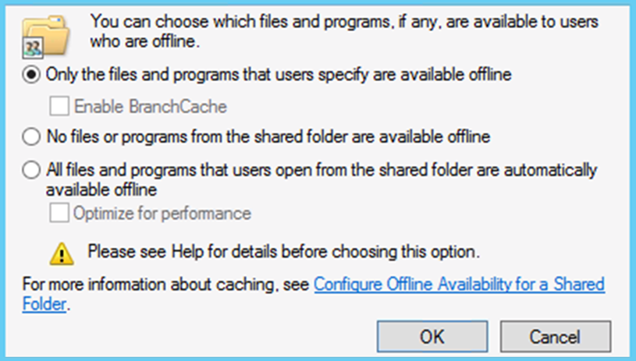
What Is the Offline Files Feature?
Offline Files allow a client computer to cache network files locally for offline use when they are disconnected from the network
Offline settings window
Notes:
Introduce the Offline File settings, and explain how they enable clients to maintain offline copies of files and folders that are located on a network share.
Mention that offline file capabilities have been built into the Windows Server® operating system since Windows Server 2003.
Additionally, you might want to mention the client compatibility list:
Windows 8.1
Windows 8
Windows Server 2012 R2
Windows Server 2012
Windows 7
Windows Server 2008 R2
Windows Server 2008
Windows Vista®
Windows Server 2003
Introduce the Always Offline mode to students. Explain its primary purpose, and mention the Windows operating system versions that are compatible.
20410D
10: Implementing File and Print Services

Slide 10
Demonstration: Creating and Configuring a Shared Folder
In this demonstration, you will see how to:
Create a shared folder
Assign permissions for the shared folder
Configure access-based enumeration
Configure offline files
Notes:
Preparation Steps
You need the virtual machines 20410D‑LON‑DC1 and 20410D‑LON‑SVR1 for this demonstration; start them now.
Demonstration Steps
Create a shared folder
Sign in to LON‑SVR1 as Adatum\Administrator with the password Pa$$w0rd.
On the taskbar, click the File Explorer icon.
In File Explorer, in the navigation pane, expand This PC, and then click Allfiles (E:).
On the menu toolbar, click Home, click New folder, type Data, and then press Enter.
Right‑click the Data folder, and then click Properties.
In the Data Properties dialog box, click the Sharing tab, and then click Advanced Sharing.
In the Advanced Sharing dialog box, select Share this folder, and then click Permissions.
Assign permissions for the shared folder
In the Permissions for Data dialog box, click Add.
Type Authenticated Users, click Check names, and then click OK.
In the Permissions for Data dialog box, click Authenticated Users, and then under Allow, select Change permission.
Click OK to close the Permissions for Data dialog box.
Click OK to close the Advanced Sharing dialog box.
Click Close to close the Data Properties dialog box.
20410D
10: Implementing File and Print Services
(More notes on the next slide)

Slide 11
Notes:
Configure access‑based enumeration
On the taskbar, click the Server Manager icon.
In Server Manager, in the navigation pane, click File and Storage Services.
On the File and Storage Services page, in the navigation pane, click Shares. You may need to refresh the view to see the Shares.
In the Shares pane, right‑click Data, and then click Properties.
In the Data Properties dialog box, click Settings, and then select Enable access‑based enumeration.
Click OK to close the Data Properties dialog box.
Close Server Manager.
Configure Offline Files
In File Explorer, navigate to drive E, right‑click the Data folder, and then click Properties.
In the Data Properties dialog box, click the Sharing tab, click Advanced Sharing, and then click Caching.
In the Offline Settings dialog box, select No files or programs from the shared folder are available offline, and then click OK.
Click OK to close the Advanced Sharing dialog box.
Click Close to close the Data Properties dialog box.
Leave all virtual machines in their current state for subsequent demonstrations.
20410D
10: Implementing File and Print Services

Slide 12
Lesson 2: Protecting Shared Files and Folders by Using Shadow Copies
What Are Shadow Copies? Considerations for Scheduling Shadow Copies Restoring Data from a Shadow Copy Demonstration: Restoring Data from a Shadow Copy
Notes:
Provide a brief overview of the lesson content.
20410D
10: Implementing File and Print Services

Slide 13
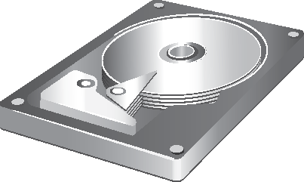
What Are Shadow Copies?
Allow access to previous versions of files
Are based on tracking disk changes
Disk space is allocated on the same volume
When the space is full, older shadow copies are removed
Are not a replacement for backups
Are not suitable for recovering databases
Notes:
Describe how shadow copies are based on disk changes rather than copies of files. This is an important distinction between shadow copies and backups.
Some students might be concerned about using too much disk space for shadow copies. However, this should not be a concern because you can control the amount of disk space allocated for shadow copies.
Ensure that students understand why shadow copies are not a suitable replacement for backups, and are not suitable for recovering databases.
20410D
10: Implementing File and Print Services

Slide 14
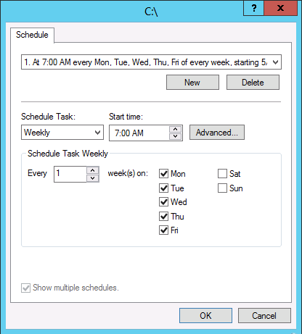

Considerations for Scheduling Shadow Copies
Default schedule is 7:00 A.M. and noon
Create a shadow copy schedule
based on:
Capacity of server
Frequency of changes
Importance of changes
Notes:
Discuss the default schedule, and whether it is suitable for students’ organizations. For most organizations, the default schedule is acceptable and provides a better ability to restore accidentally deleted or modified files than a server backup provides.
20410D
10: Implementing File and Print Services

Slide 15

Restoring Data from a Shadow Copy
Previous versions are accessible from the Properties dialog box of a file or folder
Administrators can restore previous versions directly on the server
Users can restore previous versions over the network
All users can:
Restore a file or folder
Browse previous versions to select the correct one
Copy a file or folder to an alternate location
Notes:
It is important students understand the general process for restoring a previous version. Explain that you can access previous versions from the file or folder’s Properties dialog box. Administrators can do this directly on the file server, and users can perform this over a network.
20410D
10: Implementing File and Print Services

Slide 16
Demonstration: Restoring Data from a Shadow Copy
In this demonstration, you will see how to:
Configure shadow copies
Create a new file
Create a shadow copy
Modify the file
Restore the previous version
Notes:
Preparation Steps
You need the 20410D‑LON‑SVR1 and 20410D‑LON‑DC1 virtual machines to complete this demonstration. They should be running after the previous demonstration.
Demonstration Steps
Configure shadow copies
On LON‑SVR1, on the taskbar, click the File Explorer icon.
In File Explorer, right‑click Local Disk (C:), and then click Configure Shadow Copies.
In the Shadow Copies dialog box, click C:\, and then click Enable.
In the Enable Shadow Copies dialog box, click Yes.
Click OK.
Create a new file
In File Explorer, browse to drive C, and then click the New folder icon on the Quick Launch toolbar.
Name the new folder Data, and then press Enter.
Browse to the Data folder on drive C.
In the Data folder, right‑click an empty space, point to New, and then click Text Document.
Name the new text document TestFile, and then press Enter.
Double‑click TestFile.txt to open the document.
In Notepad, type Version 1.
Close Notepad, and then click Save to save the changes.
20410D
10: Implementing File and Print Services
(More notes on the next slide)

Slide 17
Notes:
Create a shadow copy
In File Explorer, right‑click Local Disk (C:), and then click Configure Shadow Copies.
In the Shadow Copies dialog box, click Create Now.
When the shadow copy is complete, click OK.
Modify the file
In File Explorer, double‑click TestFile.txt.
In Notepad, type Version 2.
Close Notepad, and then click Save to save the changes.
Restore the previous version
In File Explorer, in the Data folder, right‑click TestFile.txt, and then click Restore previous versions.
In the TestFile.txt Properties dialog box, on the Previous Versions tab, click the most recent file version, and then click Restore.
In the Are you sure you want to restore message, click Restore.
Click OK to close the success message.
Click OK to close the TestFile.txt Properties dialog box.
Double‑click TestFile.txt to open the document, and then verify that the previous version is restored.
Close all open windows.
Leave all virtual machines in their current state for subsequent demonstrations.
20410D
10: Implementing File and Print Services

Slide 18
Lesson 3: Configuring Work Folders
What Is the Work Folders Role Service? Benefits and Limitations of Work Folders Components of Work Folders Configuring Work Folders Demonstration: How to Configure Work Folders
Notes:
20410D
10: Implementing File and Print Services

Slide 19


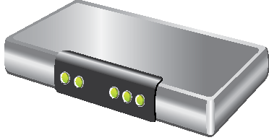
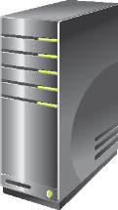
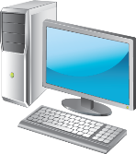



What Is the Work Folders Role Service?
https://Workfolders.Contoso.com
AD DS
Reverse Proxy
User Devices
User Devices
File management techniques:
Quotas
File screens
Reporting
Classification
Security polices to enforce encryption, lock devices, and wipe corporate data off of devices
Notes:
Use the slide to explain how Work Folders work.
Explain that Work Folders is similar to a redirected Documents folders or Offline Folders. But unlike Offline Folders and redirected folders, which generally require users to be on the LAN or have a virtual private network (VPN) connection in order to update the corporate server, Work Folders uses URLs over secure connections. Data can be made available to users wherever they are.
20410D
10: Implementing File and Print Services

Slide 20
Benefits and Limitations of Work Folders
The benefits of Work Folders include:
Works on domain-joined devices and devices that are not domain-joined
Provides a single point of access to work files
Provides offline access to work files
Synchronizes files for users
Enables data encryption
Works with existing data management technologies
The limitations of Work Folders include:
Works on Windows Server 2012 R2 and Windows 8.1 only
Does not support collaborative scenarios
Does not permit selective synchronization of files
Does not synchronize multiple file shares
Notes:
Stress that this is not a collaboration feature. Users cannot give other users access to their work folders.
20410D
10: Implementing File and Print Services

Slide 21
Components of Work Folders
Software requirements
Windows Server 2012 R2 file server
Windows 8.1 client
SSL certificates
NTFS or ReFS volume for both client and server
Server components
Client components
Manual deployment using built-in Control Panel item
Automatic deployment via Group Policy, Configuration Manager, or Intune
Work Folders role service File Server role service Web Server (IIS) role | IIS Management Console role service IIS Hostable Web Core role service
Notes:
Stress that this feature is currently available only to Windows Server 2012 R2 and Windows 8.1 clients. Mention that there is no capability for a server to be a client. There is no item on Control Panel on a server to configure Work Folders.
20410D
10: Implementing File and Print Services

Slide 22
Configuring Work Folders
Server configuration
Install the Work Folders role service
Create a sync share
Install a server certificate which has the same common name as the Work Folders URL
Client configuration
For manual configuration, the user enters their email address manually
For automatic configuration, you can use Group Policy
Notes:
Stress that Group Policy affects only domain joined devices. For devices that are not joined to the domain, you can use Windows Intune™ for automatic configuration.
20410D
10: Implementing File and Print Services

Slide 23
Demonstration: How to Configure Work Folders
In this demonstration, you will see how to:
Install the Work Folders role service
Create a sync share for work folders on a file server
Configure Work Folder access on a Windows 8.1 client
Create a file in the work folder
Configure Work Folders to sync data on a second Windows 8.1 client
Notes:
Explain that for the purposes of this demonstration, a registry entry was added to allow unsecured connections to work folders. Under normal circumstances, you are required to use Secure Sockets Layer (SSL) certificates to secure the connections between the client devices and the sync share.
Preparation Steps
You need the 20410D‑LON‑SVR1 and 20410D‑LON‑DC1 virtual machines to complete this demonstration. They should be running after the previous demonstration.
Start both the 20410D‑LON‑CL1 and the 20410D‑LON‑CL2 virtual machines.
Demonstration Steps
Install the Work Folders role service
On LON‑SVR1, in Server Manager click Add roles and features.
In the Add Roles and Features Wizard, click Next.
On the Select installation type page, click Next.
On the Select destination server page, click Next.
On the Select server roles page, expand File and Storage Services (2 of 12 installed), and then expand File and iSCSI Services (1 of 11 installed).
Select Work Folders, click Add Features, and then click Next.
On the Select features page, click Next.
On the Confirm installation selections page, click Install.
When the installation completes, click Close.
Create a sync share on a file server
In Server Manager, click File and Storage Services, and then click Work Folders.
In the details pane, click the Tasks drop-down arrow, and then click New Sync Share.
In the New Sync Share Wizard, click Next.
20410D
10: Implementing File and Print Services
(More notes on the next slide)

Slide 24
Notes:
On the Select the server and path page, ensure that LON‑SVR1 is selected, click Select by file share, and then click Next.
This procedure uses the shared folder Data which was created in the demonstration "Creating and Configuring a Shared Folder".
On the Specify the structure for user folders page, click Next.
On the Enter the sync share name page, type WorkFolders, and then click Next.
On the Grant sync access to groups page click Add.
In the Select User or Group dialog box, type Domain Users, click OK, and then click Next.
On the Specify device policies page click Next.
On the Confirm selections page, click Create, and then click Close when complete.
Configure Work Folder access on a Windows 8.1 client
Sign in to LON‑CL1 as Adatum\Administrator with the password Pa$$w0rd.
On the Start screen, click Desktop.
On the taskbar, click the File Explorer icon.
Navigate to C:\Labfiles\Mod10, and then double-click WorkFolders.bat.
This batch file adds a registry entry that allows unsecured connections to work folders.
Close File Explorer.
In the lower-left corner of the screen, right-click Start, and then click Control Panel.
Click System and Security, and then click Work Folders.
In the Work Folders dialog box, click Set up Work Folders, and then click Enter a Work Folders URL instead.
On the Enter a Work Folders URL page, type http://lon‑svr1.adatum.com, and then click Next.
Normally this requires a secure connection.
(More notes on the next slide)
20410D
10: Implementing File and Print Services

Slide 25
Notes:
On the Introducing Work Folders page, click Next.
On the Security policies page, select the check box to accept the policies, and then click Set up Work Folders.
Close the Work Folders dialog box, and then on the taskbar, click the File Explorer icon.
Notice there is now a Work Folders folder under the This PC folder.
Create a file in the work folder
Double-click the Work Folders icon to open the folder.
Right-click a blank space in the details, click New>Text Document, and then press Enter.
Synchronize data on a second client computer
Sign in to LON‑CL2 as Adatum\Administrator with the password Pa$$w0rd.
On the Start screen, click Desktop.
Right-click the Start charm, and then click Network Connections.
Right-click the Ethernet 2 adapter, and then click Enable.
Close Network Connections.
Repeat steps 4 through 12 from the Configure Work Folder access on a Windows 8.1 client task.
Open the Work Folders folder, and then notice the file that you created is available from this computer.
Close all open windows.
On the host computer, open Hyper‑V manager, and then locate 20410D‑LON‑CL2. Right‑click the virtual machine, and then click Revert.
Leave all virtual machines in their current state for subsequent demonstrations.
20410D
10: Implementing File and Print Services

Slide 26
Lesson 4: Configuring Network Printing
Benefits of Network Printing What Is Enhanced Point and Print? Security Options for Network Printing Demonstration: Creating Multiple Configurations for a Print Device What Is Printer Pooling? What Is Branch Office Direct Printing? Deploying Printers to Clients
Notes:
Briefly describe the lesson content.
20410D
10: Implementing File and Print Services

Slide 27
Benefits of Network Printing
Benefits of network printing include:
Centralized management via the Print Management Console
Simplified troubleshooting
Lower total costs
Easier searching
Notes:
This topic introduces the rest of the lesson, which provides more details on network printing.
20410D
10: Implementing File and Print Services

Slide 28
What Is Enhanced Point and Print?
Enhanced Point and Print uses the v4 driver model to provide a simplified management structure for network printer drivers
Benefits of Enhanced Point and Print :
Print servers do not need to store client print drivers
Driver files are isolated, preventing file naming conflicts
A single driver can support multiple devices
Driver packages are smaller and install faster
The print driver and the printer user interface can be deployed independently
Notes:
Introduce Enhanced Point and Print, emphasizing that is not so much an implemented feature as it is a by‑product of the new version 4 (v4) driver model.
Introduce the differences between version 3 (v3) and v4 drivers, and illustrate the benefits of using v4 drivers, especially for network print devices that a Windows Server 2012 print server hosts.
20410D
10: Implementing File and Print Services

Slide 29
Security Options for Network Printing
The default security allows everyone to:
Print
Manage their own print jobs
The available permissions are:
Print
Manage this printer
Manage documents
Notes:
Explain to students that, in most cases, default permission are acceptable for printers. However, some organizations might want to restrict what can be printed on some printers, such as those printers with high consumable costs; those that print checks; or those that are used to print highly confidential materials, such as in a human resources or legal department.
20410D
10: Implementing File and Print Services

Slide 30
Demonstration: Creating Multiple Configurations for a Print Device
In this demonstration, you will see how to:
Create a shared printer
Create a second shared printer using the same port
Increase printing priority for a high priority print queue
Notes:
Preparation Steps
You need the 20410D‑LON‑SVR1 and 20410D‑LON‑DC1 virtual machines to complete this demonstration. They should be running after the previous demonstration.
Demonstration Steps
Create a shared printer
On LON‑SVR1, in the lower-left corner of the screen, click the Start button
In the Start box, type Devices, and then click Devices and Printers.
In the Devices and Printers window, click Add a printer.
In the Add Printer Wizard, on the Select a Printer page, click The printer that I want isn’t listed.
Click Add a local printer or network printer with manual settings, and then click Next.
Other connections options are also available in this dialog box.
Click Use an existing port, ensure that LPT1: (Printer Port) is selected, and then click Next.
You can create other ports here manually, including TCP/IP, for network‑connected printers.
Leave the driver choice as the default, and then click Next.
Change the printer name to AllUsers, and then click Next to finish the printer installation.
On the Printer Sharing page, ensure that the printer is shared, and then click Next.
Click Finish to close the Add Printer Wizard.
Create a second shared printer on the same port
In the Devices and Printers window, click Add a printer.
In the Add Printer Wizard, on the Select a Printer page, click The printer that I want isn’t listed.
20410D
10: Implementing File and Print Services
(More notes on the next slide)

Slide 31
Notes:
Click Add a local printer or network printer with manual settings, and then click Next.
On the Choose a printer port page, click Next.
This is the same port that you selected for the printer you created in the previous task.
On the Install the printer driver page, click Next to accept the default selection.
This is the same printer driver that you used for the printer you created in the previous task.
On the Which version of the driver do you want to use page, click Next to reuse the same printer driver.
On the Type a printer name page, in Printer name, type Executives, and then click Next.
On the Printer Sharing page, click Next to share the printer with the default settings.
On the You’ve successfully added Executives page, click Finish.
In the Devices and Printers window, review the list of devices.
Notice that only the Executives printer displays.
Increase printing priority for a high priority print queue
In the Devices and Printers window, right‑click Executives, point to Printer properties, and then click Executives.
On the Advanced tab, in Priority, type 10, and then click OK.
Now jobs that are submitted to the Executives printer have higher priority that those submitted to the AllUsers printer, and will be printed first.
After you complete the demonstration, revert all virtual machines.
20410D
10: Implementing File and Print Services

Slide 32
What Is Printer Pooling?
Printer pooling combines multiple physical printers into a single logical unit
A printer pool increases availability and scalability
Requirements:
All printers must use the same driver
All printers should be in the same location
Notes:
Printer pooling often is overlooked, so you should explain to students why it is beneficial, especially if they are in an organization that has capacity concerns with respect to printing. Explain how printer pooling differs from using multiple printers, because with printer pooling, other printers are made available automatically. A user does not have to look for a printer that is not busy, and then select it before printing.
20410D
10: Implementing File and Print Services

Slide 33
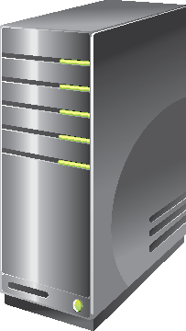

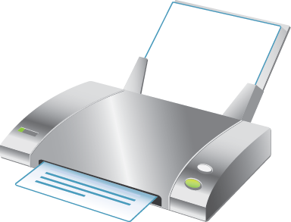
What Is Branch Office Direct Printing?
Branch Office Direct Printing enables client computers to print directly to network printers that are shared on a print server
Main Office
Print Server
Print Request
Print Redirect
Branch Office
Print Job
Client Computer
Managed Printer
Notes:
Introduce Branch Office Direct Printing and the methods for enabling it.
Ensure that students understand the difference between printer pooling and Branch Office Direct Printing.
20410D
10: Implementing File and Print Services

Slide 34


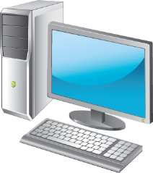


Deploying Printers to Clients
You can deploy printers to clients by using:
Group Policy preferences
GPO created by Print Management
Manual installation
Notes:
Some students may be unfamiliar with the options to deploy printers by using Group Policy preferences or Group Policy Objects (GPOs) which have been created by Print Management. If students express an interest in this topic, spend some extra time discussing these.
20410D
10: Implementing File and Print Services

Slide 35
Lab: Implementing File and Print Services
Exercise 1: Creating and Configuring a File Share Exercise 2: Configuring Shadow Copies Exercise 3: Enabling and Configuring Work Folders Exercise 4: Creating and Configuring a Printer Pool
Logon Information
Virtual machines 20410D‑LON‑CL1
20410D‑LON‑DC1
20410D‑LON‑SVR1
User name Adatum\Administrator
Password Pa$$w0rd
Estimated Time: 60 minutes
Notes:
Before students begin the lab, read the lab scenario and display the next slide. Before each exercise, read the scenario associated with the exercise to the class. The scenarios give context to the lab and exercises, and help to facilitate the discussion at the end of the lab. Remind students to complete the discussion questions after the last lab exercise.
Exercise 1: Creating and Configuring a File Share
Your manager has asked you to create a new shared folder, which all departments will use. There will be a single file share, with separate folders, for each department. To ensure that users see only the folders and files to which they have access, you need to set the file permissions on the departmental folders and enable access‑based enumeration on the share.
There have been problems in other branch offices with multiple versions of files when offline files were used for shared data structures. To avoid these conflicts, you need to disable Offline Files for this share.
Exercise 2: Configuring Shadow Copies
A. Datum Corporation stores daily backups offsite for disaster recovery. Every morning, the backup from the previous night is taken offsite. To recover a file from backup, the backup tapes need to be shipped back onsite so the overall time to recover a file from backup can be a day or more.
Your manager has asked you to enable shadow copies on the file server so you can restore recently modified or deleted files without using a backup tape. Because the data in this branch office changes frequently, you are going to create a shadow copy once per hour.
Exercise 3: Enabling and Configuring Work Folders
You must enable and configure Work Folders to support the requirements of your users. Domain users have their own Windows 8.1 and Windows RT 8.1 tablet devices and want access to their work data from anywhere. When they return to work, they want to be able to synchronize these data files. You will use Group Policy to force the Work Folders settings to users and test the settings.
Instructor Note: Explain that students will be adding a registry entry to allow unsecured connections to the work folders. This is for the purposes of this lab exercise only. You would not do this in a normal production environment.
20410D
10: Implementing File and Print Services
(More notes on the next slide)

Slide 36
Notes:
Exercise 4: Creating and Configuring a Printer Pool
Your manager has asked you to create a new shared printer for your branch office. However, instead of creating the shared printer on the local server in the branch office, he has asked you to create the shared printer in the head office and use Branch Office Direct Printing. This allows people in the head office to manage the printer, but prevents print jobs from traversing WAN links.
To ensure high availability of this printer, you need to format it as a pooled printer. Two physical print devices of the same model have been installed in the branch office for this purpose.
20410D
10: Implementing File and Print Services

Slide 37
Lab Scenario
Your manager has recently asked you to configure file and print services for the branch office. This requires you to configure a new shared folder that will have subfolders for multiple departments, configure shadow copies on the file servers, and configure a printer pool.
Additionally, many users want to be able to work on their data files while they are out of the office and working on devices such as on Windows RT‑based tablets. You must ensure that these users are able to access their work-related data files from other locations when offline.
Notes:
20410D
10: Implementing File and Print Services

Slide 38
Lab Review
How does implementing access-based enumeration benefit the users of the Data shared folder in this lab? Is there another way you could recover the file in the shadow copy exercise? What benefit do shadow copies provide in comparison? In Exercise 3, how could you configure Branch Office Direct Printing if you were in a remote location and did not have access to the Windows Server 2012 GUI for the print server?
Notes:
Lab Review Questions
Question
How does implementing access-based enumeration benefit the users of the Data shared folder in this lab?
Answer
With access‑based enumeration, users see only the folders for their department, so it is easier to navigate within the folder structure. Access‑based enumeration also increases the network's security because users cannot see any folders and files for which they do not have permissions.
Question
Is there another way you could recover the file in the shadow copy exercise? What benefit do shadow copies provide in comparison?
Answer
Within the lab itself, the user could recover the file from the Recycle Bin. However, in a real-world scenario, the Recycle Bin is not available for network shared folders. The file would have to be recovered from a backup if shadow copies were not available.
In comparison, shadow copies maintain multiple, persistent copies of modified files that an administrator or end user can recover.
Question
In Exercise 3, how could you configure Branch Office Direct Printing if you were in a remote location and did not have access to the Windows Server 2012 GUI for the print server?
Answer
You could configure Branch Office Direct Printing by using Windows PowerShell to connect remotely from a Windows 8 or Windows Server 2012 computer. Then, you could use the Set‑Printer cmdlet to change the configuration.
20410D
10: Implementing File and Print Services

Slide 39
Module Review and Takeaways
Review Questions Tools
Notes:
Module Review Questions
Point students to the appropriate section in the course so that they are able to answer the questions that this section presents.
Question
How does inheritance affect explicitly assigned permissions on a file?
Answer
While inherited permissions accumulate with explicit permissions, explicitly assigned permissions always take precedence over inherited permissions.
Question
Why should you not use shadow copies as a means for data backup?
Answer
While shadow copies can store copies of files and protect against issues such as accidental deletion, they are reliant on the local files system and Windows Server 2012 for their functionality. Hard drive corruption, or destruction of the local machine, renders shadow copies useless in a disaster-recovery situation.
Question
In which scenarios could Branch Office Direct Printing be beneficial?
Answer
You should use Branch Office Direct Printing if the WAN connection between a printer and a print server is slow or unreliable. When clients are in the same physical location as the printer, and they use Branch Office Direct Printing, documents are printed quicker and network bandwidth is freed up because print jobs are sent from the client computer directly to the printer and not to the central server and then back to the branch office printer.
20410D
10: Implementing File and Print Services
(More notes on the next slide)

Slide 40
Notes:
Tools
20410D
10: Implementing File and Print Services

